Slide 1
Numpy

Slide 2
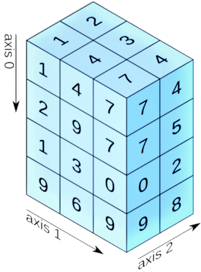
What’s the NumPy (numerical python)?
3D array
2D array
5 | 7 | 8 | 2
10 | 2 | 3 | 1
4 | 5 | 7 | 10
1D array
Axis 0
1 | 2 | 5 | 4 | 7 | 1 | 2 | 3 | 6 | 9
Axis 0
Axis 1
Shape: (10,)
Shape: (3,4)
Shape: (4,3,2)

Slide 3


How are lists are different from Numpy?
List
NumPy
slow
Very fast

Slide 4
Why is NumPy faster? –Fixed Type
3 | 7 | 2
5 | 1 | 0
4 | 10 | 3
Binary Int8
5
Computer
00000101
Binary Int32
5
NumPy
00000000 00000000 00000000 00000101

Slide 5
Why is NumPy faster?
Default int type info
Size
00000000 00000000 00000000 00011100
Reference count
000000001 00111101 11111110 10111100 00000000 00000000 00000000 00011100
Int in lists
Object Type
110001010 10111110 01100001 01000100 11111100 00000000 11001100 01011111
Object Value
000000000 00000000 00000000 00000000 00000000 00000000 00000000 00000101

Slide 6
Why is NumPy faster?
Faster to read less bytes of memory
No type checking when iterating through objects

Slide 7
Why is NumPy faster? -Contiguous storing
Memory
List
Memory
NumPy
Benefits:- can do SIMD vector processing.
Effective cache utilization.

Slide 8
How lists are different from NumPy arrays?
Lists
NumPy array
Insertion, deletion,
appending, concatenation, etc.
Insertion, deletion,
appending, concatenation, etc.
A = [1,3,5] A = [1,3,5]
B = [1,2,3] B = [1,2,3]
A*B = Error
A*B = [1,16,15]

Slide 9
Applications of NumPy?
Mathematics
Plotting (Matplotlib)
Backend (Pandas, Connect 4, Digital photography)
Machine learning

